Slide 1
COMPUTER VISION PROJECT
RNN vs. LSTM for Human Action Recognition
Comparing Temporal and Averaging Evaluation Strategies on the KTH Action Dataset
Muhammad Umer & Muhmmad Irtisam
005 & 006
BS Artificial Intelligence — Semester 6
University of Sialkot — Department of Artificial Intelligence

Slide 2
Agenda
01
Problem & Objectives
Why RNN vs LSTM, and why two evaluation strategies
02
Dataset
KTH Action Recognition — 6 classes, 599 clips
03
Methodology
MobileNetV2 features → RNN / LSTM → dual evaluation
04
Results
Accuracy, confusion matrices, class-wise breakdown
05
Robustness Test
Frame-shuffle experiment
06
Conclusion & Future Work
2

Slide 3
Why RNN vs. LSTM?
The Problem
Simple RNN vs. LSTM
Actions like walking, jogging, and running look almost identical in a single frame.
They differ mainly in motion pattern over time — stride speed, frequency.
This requires a model that can retain information across a sequence of frames.
Simple RNN: updates a hidden state each step, but suffers from vanishing gradients over longer sequences.
LSTM: uses input/forget/output gates to preserve information over longer time spans.
Hypothesis: LSTM should better separate visually similar, motion-differentiated actions.
3

Slide 4
Project Objectives
1
Build a complete action-recognition pipeline from raw video to trained classifiers
2
Train RNN and LSTM under identical conditions for a fair comparison
3
Evaluate both using two strategies: Temporal (last frame) vs. Averaging (mean-pooled)
4
Analyse per-class performance via confusion matrices and classification reports
5
Test genuine temporal reliance with a frame-order shuffle experiment
6
Compare computational cost (training time) between architectures
4

Slide 5
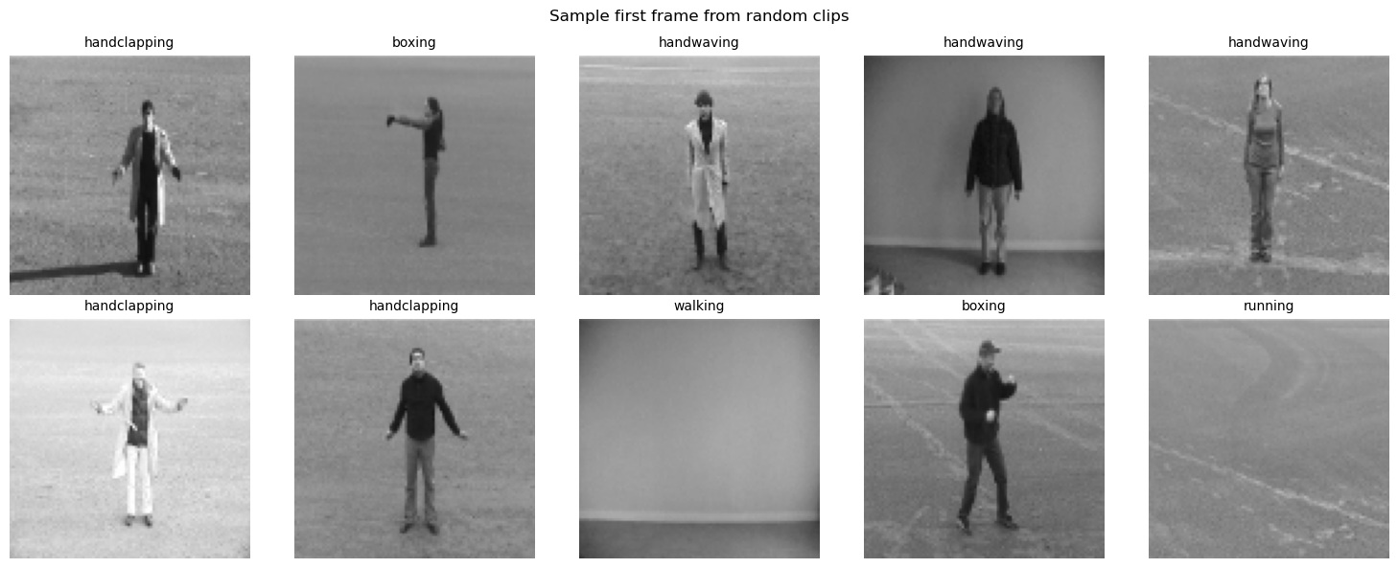
Dataset: KTH Action Recognition
6
action classes
599
video clips used
16
frames sampled / clip
96×96
frame resolution
Static camera
homogeneous background
Classes: boxing · handclapping · handwaving · jogging · running · walking
5

Slide 6
Pipeline: From Video to Prediction
1
2
3
4
Frame Extraction
→
MobileNetV2 Features
→
RNN / LSTM
→
Dual Evaluation
16 frames / video, 96×96, RGB
Frozen CNN → 1280-D vector / frame
Sequence classifier, per-frame softmax output
Temporal (last step) vs. Averaging (mean pooled)
Both models share identical preprocessing, features, optimiser, and training schedule — isolating the effect of architecture choice.
6

Slide 7
Theoretical Background: Recurrent Neural Networks
How an RNN Processes a Sequence
Unrolled Through Time
At each time step t, the network combines the current input xₜ with the previous hidden state hₜ₋₁ to produce a new hidden state:
hₜ = tanh( Wₓₕ xₜ + Wₕₕ hₜ₋₁ + bₕ )
x₁
→
x₂
→
xₜ
⋯
yₜ = softmax( Wₕᵧ hₜ + bᵧ )
Each cell reuses the SAME weights (Wₓₕ, Wₕₕ) at every step — this weight-sharing is what causes repeated multiplication during backpropagation.
The hidden state hₜ acts as the network's memory, carrying information forward through the sequence.
Training uses Backpropagation Through Time (BPTT): gradients are propagated backward across all 16 time steps to update Wₓₕ and Wₕₕ.
7

Slide 8
Theoretical Background: LSTM Gating Mechanism
An LSTM cell maintains a separate cell state Cₜ (its “long-term memory”) and regulates it using three gates, each a sigmoid layer producing values between 0 and 1:
Forget Gate
Input Gate
Output Gate
fₜ = σ(W_f·[hₜ₋₁, xₜ] + b_f)
iₜ = σ(W_i·[hₜ₋₁, xₜ] + b_i)
oₜ = σ(W_o·[hₜ₋₁, xₜ] + b_o)
Decides what fraction of the old cell state Cₜ₋₁ to keep
Decides how much new candidate information to add
Decides how much of Cₜ to expose as the hidden state
Cell State Update (the key to long-range memory)
Cₜ = fₜ ⊙ Cₜ₋₁ + iₜ ⊙ C̃ₜ hₜ = oₜ ⊙ tanh(Cₜ)
This update is largely additive (⊙ = element-wise product) rather than repeatedly passed through a single nonlinearity — giving gradients a more direct path across time steps.
8

Slide 9
The Vanishing Gradient Problem
Simple RNN
LSTM
∂hₜ / ∂h₀ = ∏ₜ ∂hₖ / ∂hₖ₋₁
∂Cₜ / ∂Cₜ₋₁ = fₜ (element-wise)
The gradient of the loss with respect to an early hidden state is a product of many Jacobians, one per time step.
Each factor is bounded by the tanh derivative (≤ 1) and the recurrent weight matrix.
Multiplying ~16 such factors together tends to shrink the gradient toward zero — early time steps stop receiving useful learning signal.
The cell state's gradient path is additive and gated by fₜ, rather than passed through a shared weight matrix and squashing nonlinearity at every step.
When the forget gate is close to 1, gradients flow through the cell state largely unchanged across many time steps.
This is why the LSTM can learn dependencies (e.g., stride frequency across all 16 frames) that the Simple RNN struggles to retain.
9

Slide 10
Theoretical Background: Transfer Learning with MobileNetV2
Depthwise Separable Convolutions
Why Freeze the Feature Extractor?
A standard convolution filters and combines channels in one step — computationally expensive.
MobileNetV2 splits this into a depthwise convolution (filters each channel separately) followed by a pointwise 1×1 convolution (combines channels).
This factorisation cuts computation substantially while retaining representational power — ideal for CPU-only feature extraction.
Transfer learning reuses filters learned on large-scale ImageNet data — general edge, texture, and shape detectors.
With only 599 videos, training a full CNN from scratch would risk severe overfitting.
Freezing MobileNetV2 and training only the RNN/LSTM layers keeps the learning capacity matched to the amount of available data.
10

Slide 11
Model Architectures
Simple RNN
LSTM
Layer | Output | Params
SimpleRNN (128) | (16,128) | 180,352
SimpleRNN (64) | (16,64) | 12,352
TimeDist. Dense(64) | (16,64) | 4,160
TimeDist. Dense(6) | (16,6) | 390
Layer | Output | Params
LSTM (128) | (16,128) | 721,408
LSTM (64) | (16,64) | 49,408
TimeDist. Dense(64) | (16,64) | 4,160
TimeDist. Dense(6) | (16,6) | 390
Total: 197,254 parameters
Total: 775,366 parameters (≈ 4× RNN)
Prone to vanishing gradients over longer sequences — limited long-range memory.
Gated memory cell mitigates vanishing gradients — better long-range retention.
11

Slide 12
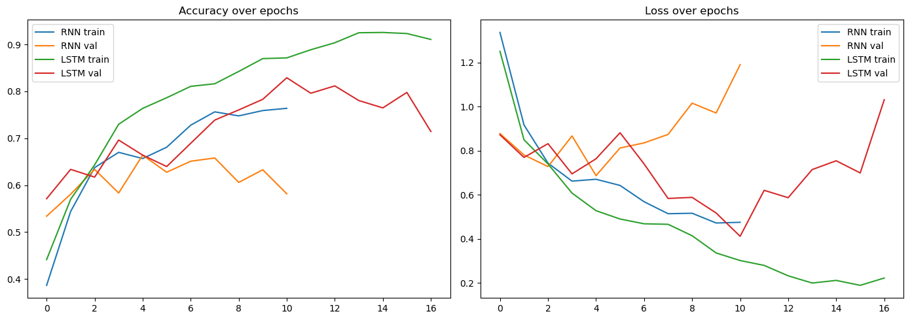
Training Behaviour
RNN: validation accuracy plateaus (~0.58–0.66) with rising validation loss — early overfitting.
LSTM: smoother climb to a validation accuracy peak of 0.83, before early stopping restores the best epoch.
12

Slide 13
Performance Comparison
13

Slide 14
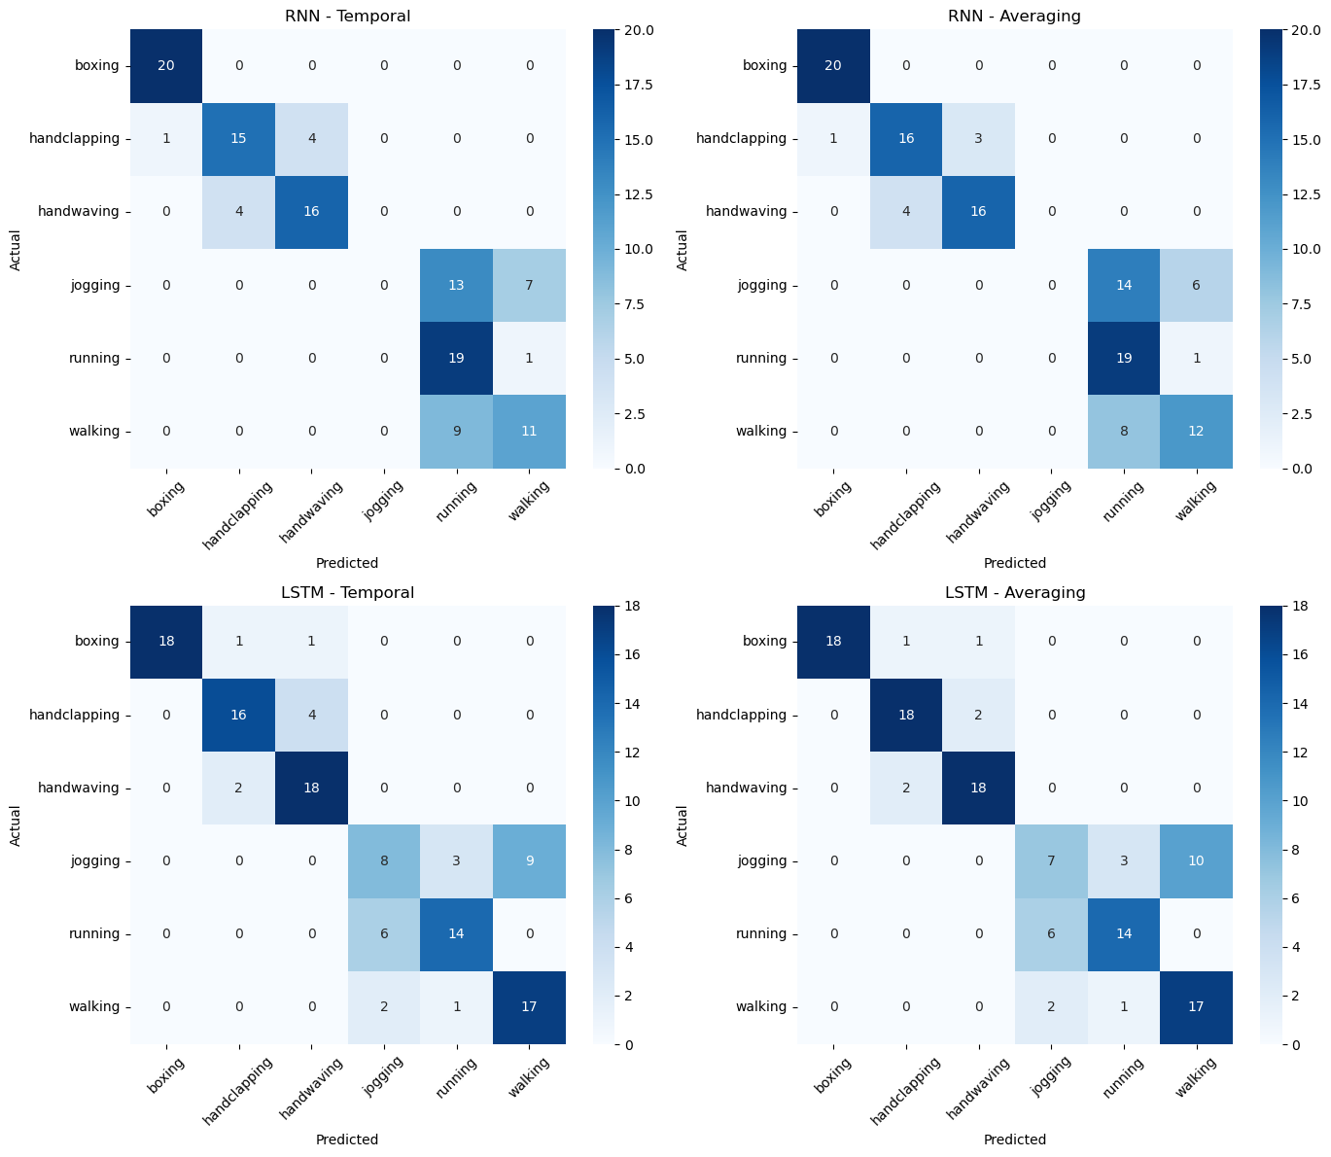
Confusion Matrix Analysis
14

Slide 15
Key Finding: The Jogging Problem
RNN
LSTM
0%
~40%
precision & recall on ‘jogging’ — never predicted correctly, absorbed entirely into running/walking
recall on ‘jogging’ — correctly separates all three locomotion classes, none fully collapsed
Both models classify boxing, hand clapping, and hand waving with high accuracy — the gap is concentrated entirely in the locomotion classes, where distinguishing information is spread across the full sequence.
15

Slide 16
Training Time & Model Size
LSTM trains ~2.2× slower and has ~4× more parameters — but both remain under a minute thanks to precomputed CNN features.
16

Slide 17
Robustness Test: Frame-Order Shuffle
Do the models actually rely on frame order? We shuffled test-set frames and re-evaluated — no retraining.
17

Slide 18
What the Shuffle Test Reveals
LSTM – Temporal
0.758 → 0.758
No change — decision at the final step is stable regardless of order
RNN – Temporal
0.675 → 0.625
Drops 5 pts — but from an already weak, unstable baseline
Both – Averaging
small drops (0.8–1.7 pts)
Expected: averaging is inherently less order-sensitive
Conclusion: LSTM's advantage comes from better overall feature retention across the sequence — not strict dependence on frame ordering.
18

Slide 19
Conclusion
LSTM consistently outperforms RNN — F1-score 0.75–0.76 vs. 0.62–0.64
The gap is concentrated in locomotion classes (jogging / running / walking), where motion unfolds over the full sequence
Averaging evaluation gives a small, consistent edge over temporal evaluation, for both architectures
Architecture choice (RNN vs. LSTM) matters far more than aggregation-strategy choice
Shuffle test shows LSTM's edge comes from better feature retention, not strict frame-order dependence
19

Slide 20
Future Work
Motion Features
Broader Architectures
Add frame-differencing or optical flow to more directly test motion reliance
Compare GRUs and Transformer-based temporal encoders
Fine-Tuning
Larger Datasets
Unfreeze upper MobileNetV2 layers for task-specific visual features
Re-run the dual-evaluation methodology on UCF50 / UCF101
20

Slide 21
Thank You
Questions & Discussion

